Slide 1
The Job Search

Slide 2
The Three Rs of Searching for a Job
Research Yourself
Research the Company
Research the Position
What are your skills, attributes, and accomplishments?
What can you bring to the company that is unique?
How do your qualifications meet the position’s requirements?
What interests you about this company and the position?
What is the employer’s product or service?
What is the company’s vision or mission statement?
What are the needs or problems of the employer?
What role does the employer play in the community?
Is the employer expanding?
What are the job responsibilities?
What are the pay and benefits for this job?
What skills and talents are needed for the position?
What is the growth opportunity for this field?

Slide 3
Research the Internet to Find Job Openings
Use Social Media to Find Jobs
Use Mobile Apps in the Job Search
Use Traditional Job Search Techniques

Slide 4
Curriculum Vitae / Resume
Document highlighting
Qualifications
Experience
Awards
Skills of an applicant

Slide 5

Ethical Considerations When Writing a Resume
Make sure that your resume is ethical and honest.
Including a degree that you have not earned
Listing colleges or universities that you have not attended
Inflating your job title
Inflating your job responsibilities
Inflating your job achievements
Listing jobs that you have not held
Claiming technical knowledge that you do not have
Omitting large amounts of time from your school and job histories
Including military rank you have not earned

Slide 6
Key Resume Components Identification Begin your resume with the following:
Name (full first name, middle initial, and last name). Your name can be in boldface and printed in a larger type size (14 point, 16 point, etc.)
Contact information. Include your street address, your city, state, and zip code.
If required add your permanent address as well.
Area code and phone numbers. Limit yourself to two phone numbers, and don’t provide a work phone.
E-mail, Web site address, or fax number.

Slide 7
Key Resume Components
Career Objectives
like a subject line in a memo, email, or report
informs the reader of your resume’s focus
It should be precise and specific
It should emphasize how hiring you will benefit the company

Slide 8
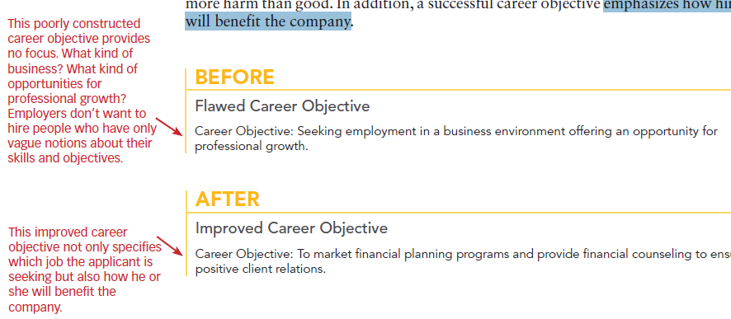
Key Resume Components

Slide 9
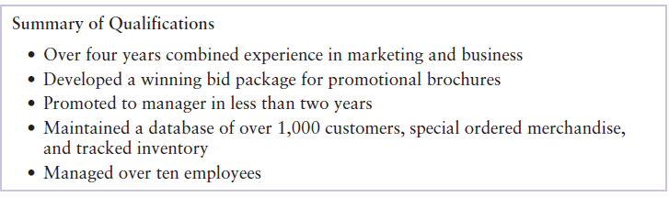
Key Resume Components
Summary of Qualifications
An overview of your skills, abilities, accomplishments, and attributes
Your strengths in relation to the position for which you are applying
How you will meet the employer’s goals
List your top three to seven most marketable credentials

Slide 10
Key Resume Components
Employment
Present the information in reverse chronological order (your current job listed first, previous jobs listed next).
Your job title (if you have or had one)
The name of the company you worked for
The location of this company (city and state)
The time period during which you worked at this job
Your job duties, responsibilities, and accomplishments

Slide 11
Key Resume Components
Education
(in reverse chronological order (most recent education first; previous schools, colleges, universities, military courses, and training seminars next)
Degree
Area of specialization
School attended
Location
Year of graduation or years attended

Slide 12
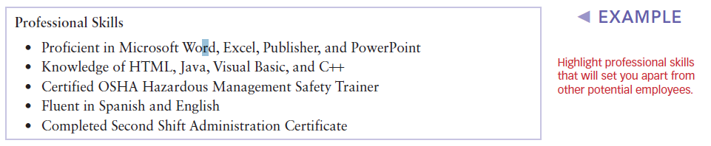
Key Resume Components
Professional Skills

Slide 13
Key Resume Components
Professional Affiliations
References
Personal Data
Do not include any of the following information: birth date, race, gender, religion, height, weight, religious affiliation, marital status, or pictures of yourself.

